Slide 1
FengWu – Data Driven Global Weather Forecasting and Its Applications on Tropical Cyclone Predictions
Lei Bai
Shanghai AI Laboratory
Notes:
Good afternoon everyone, I am Lei Bai, a research scientist from Shanghai AI Laboratory. I am sorry that I did not make it to get the visa for Germany and attend the workshop in person, which I really really want to. because there are so many applicant and it’s just so hard to book a time for the visa interview. I have been to Germany once when I was a phd candidate and visited Munich, which is a beautiful city. I hope I could visit Europe in the near future and meet you guys in person. Ok, let’s back to the presentation. Today, I will present our work FengWu, which pushes the skillful global weather forecasting beyond 10 days lead with artificial intelligence.
强度：
集合诊断 – 协方差、
暴雨、台风、结构

Slide 2
目录
1
Brief Backgrounds
2
Model Designs
3
Evaluations
4
Tropical Cyclone Predictions

Slide 3
｜ The First Part – Brief Backgrounds

Slide 4
Who are we?
Shanghai AI Laboratory
Established in 2021, Shanghai
Focusing on developing cutting-edge AI techniques
CVPR 2023 best paper, Intern (foundational model for CV and LM), FengWu
Open research with top tier universities (THU, PKU, SJTU, CUHK, NTU) and Institutions (CMA、HKO).
AI4Earth Team
A research group at Shanghai AI Laboratory, co-lead by Dr. Lei Bai (www.leibai.site)
More than 20 research scientists, PhD students, and research interns

Slide 5
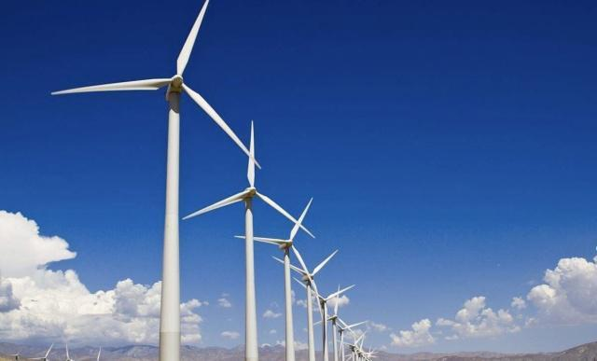
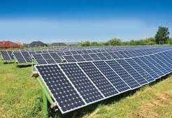
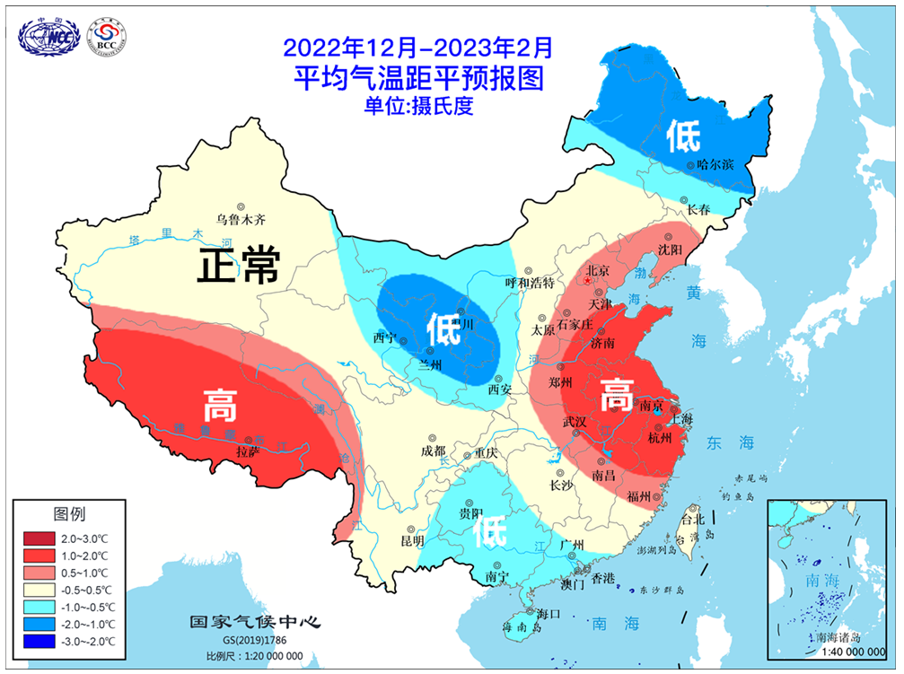
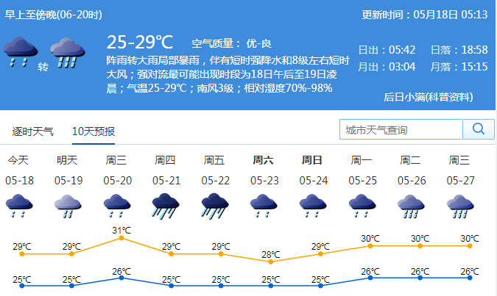
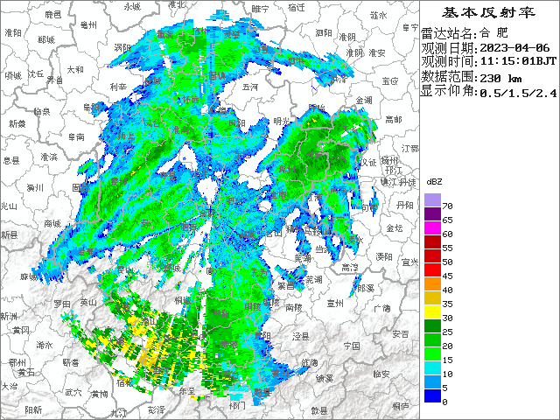
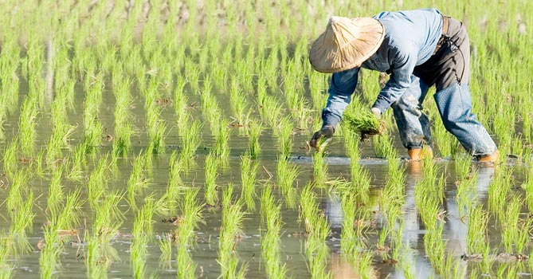
What are we doing?
Build AI-powered chip for global weather and climate forecasting
Wind energy forecast
Solar energy forecast
Seasonal forecast
Ocean forecast
Typhoon forecast
Regional forecast
Global weather and climate forecasting
Industry forecast
Short-term forecast
Notes:
For ai-based weather forecasting, our research positioning is to build AI-powered chip for global weather and climate forecasting and also support diverse key requirements including short-term forecast, regional forecast, seasonal forecast, wind energy forecast, solar energy forecast, ocean, and typhoon forecast, and support different kinds of industries.
For all of these research topics and applications, we think that the medium range global weather forecasting is in the core-position and thus we start in this task.

Slide 6
From ECMWF
Notes:
For this task, there has already been a few attempts as has been introduced in this morning so I will not wasting your time in discussing why we conduct weather forecasting with AI, and what’s the benefits of using AI.
Just using this slide from ECMWF to quick showcase the location of AI-weather forecasting development timeline, which is necessary because I will refer to these works in the following slides. As noted, ECMWF starts working on this direction in 2018 but on a low resolution. Then, FourCastNet from Nvidia first worked on the 0.25 degree in the Feb of 2022 but they did not surpass IFS. In the Novermber of 2022, Huawei further worked on the 0.25 degree and for the first time surpass IFS with AI, followed by the GraphCast from Deepmind one month later. Graphcast further achieved better performance measured by RMSE and ACC. Microfost also released a global model named Climax, but their performance is not that good due to the computation resource and resolution.
Finally, our work FengWu is released in the April of this year, and got even better performance than previous works.

Slide 7
｜ The Second Part – Model Designs

Slide 8
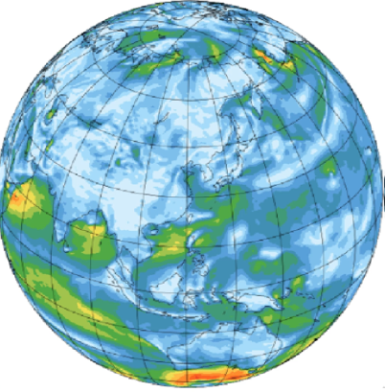
Problem and modeling
Problem：Predicting future global atmospheric conditions up to fourteen days ahead
Resolution：0.25
Region：Global
Height level：37 levels
Atmosphere variables：geopotential、temperature、humidity、u component of wind、v component of wind
Modeling：
Like physical model，the goal of FengWu is to predict the atmospheric variables at the next moment，and then all predictions are obtained by autoregressive method
Train
FengWu
FengWu
……
$$Inputx^{i}$$
$$Pred{\hat{x}}^{i+1}$$
$$Pred{\hat{x}}^{i+2}$$
$$Pred{\hat{x}}^{i+56}$$
Notes:
Now let me give the problem formulation of FegnWu. Our main objective is to forecast the global atmospheric conditions for the upcoming 14 days, although we still haven’t achieve this goal. We're working with a dataset that has a resolution of 0.25 degrees latitude and longitude. This means we divide the Earth into a grid with each cell covering 0.25 degrees. When this grid is flattened, it forms an image with dimensions 721x1440. Both our input and output are global atmospheric data, spanning 37 vertical levels.
We're primarily focused on predicting various Atmosphere variables, including geopotential, temperature, humidity, u component of wind, and v component of wind. Additionally, we're predicting four surface variables: mean sea level pressure, 2-meter temperature, 10-meter u component of wind, and 10-meter v component of wind. This adds up to a total of 189 variables.
As you may be aware of from this task description, FengWu is actually dealing with a large mount of data. For each time step, there would be 0.7 Gegabytes and thus predicting 14 days weather states at a 6-hour time interval means output about 40 gigabytes data. Directly optimizing this task is almost impossible due to the hardware limitation.
To tackle this challenge, we adopted an approach similar to that of a physical model. Fengwu's objective is to predict the atmospheric variables for the next time step based on the current moment during training. We achieve long-term forecasting through an autoregressive method. As depicted in the diagram below, during training, we input the state xi at the current time step and predict the state xi+1 for the next time step. During inference, we input the current state xi into the model, which then outputs the state xi+1 for the subsequent time step. We further input the predicted result xi+1 back into the model, generating state xi+2, and so on. This iterative process continues until we've generated atmospheric states for all 14 days with six-hour intervals.

Slide 9
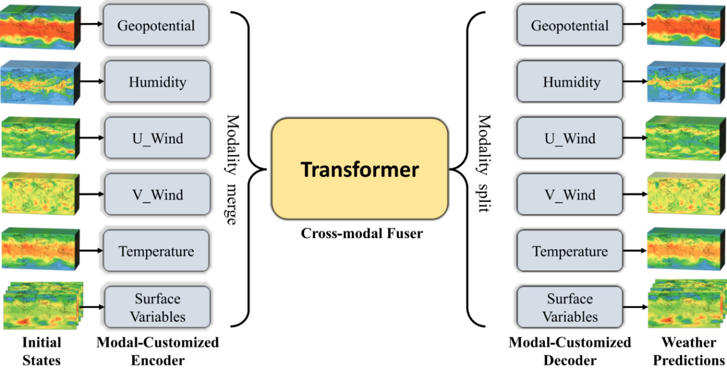
High-dimensional data representation
How to represent the high-dimensional weather data efficiently
Multi-modal: treat each variable as a separate modality
Independent encoders and decoders
Cross-modal Fuser: learning the interactions among different variables
Notes:
To get the model we want, there will still be three challenges. The first is how to represent the high-dimension weather data efficiently, for which we introduce the multi-modal design.
Multimodal refers to the fact that we employ six separate encoders to encode and decode various atmospheric variables at multiple levels and surface variables, as illustrated in the diagram. For each atmospheric variable with multiple heights, we use an independent encoder-decoder pair, and the same goes for the four surface variables. This design makes it easier for the model to learn more accurate interaction of one variable at different spaces and different vertical levels. The encoders and decoders for each variable utilize a residual connection to pass the message, which is not explicitly depicted in the diagram. Information interaction between different variables is further captured by a dedicated transformer network.

Slide 10
Network optimization
How to optimizee the network efficiently
Multi-task learning：treat the optimization of each variable at each location as a task
Uncertainty loss: automatically generating the weights of each variable at each location based on the loss [1]
$$α_{1}$$
$$α_{2}$$
$$α_{3}$$
$$α_{4}$$
$$α_{5}$$
$$α_{6}$$
[1] Kendall, A., Gal, Y. and Cipolla, R., 2018. Multi-task learning using uncertainty to weigh losses for scene geometry and semantics. In Proceedings of the IEEE conference on computer vision and pattern recognition (pp. 7482-7491).
Notes:
The second challenge is how to optimize the network efficiently. Due to the varying difficulty, importance, and precision of predicting different variables, using Mean Squared Error as the loss function might lead the model to prioritize optimizing positions and variables with large errors, while neglecting those with small errors. In atmospheric prediction, normalized data, such as z500, require higher precision. Using MSE for optimization might not be effective as the error is already small in the normalized context, causing the model to not prioritize optimizing these variables.
In previous GraphCast model, they manually assigned weights to the loss of different variables to address this. However, it will need a large mount of try-and-error since there are 189 variables to optimize and also it impossible to assign weights to each location. In this case, we approach the issue from a multi-task perspective. We use an Uncertainty loss to balance the weight of different variables in various regions. Our approach involves outputting two values for each variable at each position – one representing the mean and the other representing the variance. Using these mean and variance outputs, we construct a Gaussian distribution. Our objective is to maximize the probability of the actual value lying within the Gaussian distribution we've output. This effectively uses the standard deviation to weight each variable at each position. More details of the uncertainty loss can be found in this paper.
This approach accounts for the variability and uncertainty associated with different variables, allowing the model to focus on improving the prediction accuracy across all variables, regardless of their individual error magnitudes.

Slide 11
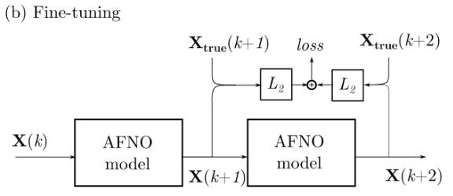
How to achieve long-lead forecasting
AutoRegressive Finetuning: FourCastNet and GraphCast
Training with larger time steps: Pangu
Notes:
The thrid challenge is how to achieve long lead forecasting under the condition that we can only optimize a few steps during training and must use autoregressive inference during testing. This challenge actually is the most core part for accurate medium-range weather forecasting because the error will accumulate with the inference step.
To solve this problem, previous works explored two strategies. One is autoregressive finetuning, which feeds the outputs into the model to generate the predicitons as the next step and optimizing all prediction at the same time during training. Autoregressive finetuning is employed by Fourcastnet and graphcast. The difference in their implementation is that FourCastnet only conduct one-step finetuning while GraphCast conducted 12 steps finetuning. However, we found that it is hard to implement the finetuning with more steps.
The other strategy is training with a larger time step, which is employed in Pangu. Different with our work and GraphCast that are training with a 6-hour time interval, pangu is trained with a 24-hour time interval, which significantly decreases the number of interations during inference and thus decrease the error accuumulation. The drawback for this strategies is that it requires the training of multiple models, which involves more computation. Besides, this method cannot be generalized to some scenarios that does not allow the trainning of larger time steps.

Slide 12
How to achieve long-lead forecasting
How to achieve long-lead forecasting
FourCastNet and GraphCast: Autoregressive finetuning
Pangu: Training with Larger time steps
FengWu: Replay buffer mechanism
The training of deep learning involves optimizing the network for a large number of iterations with the data sampled from the dataset
Replay buffer stores the predictions of prior iterations and samples training data from for the network optimization in the following iterations
FengWu
Feng Wu
……
$$Input x^{i}$$
$$Pred {\hat{x}}^{i+1}$$
$$Input {\hat{x}}^{i+1}$$
$$Pred {\hat{x}}^{i+2}$$
Cache in
Replay
Memory Queue
$${\hat{x}}^{i+1}$$
$${\hat{x}}^{i+1}$$
$${\hat{x}}^{i+2}$$
……
$${\hat{x}}^{i+10}$$
$${\hat{x}}^{i+T}$$
Notes:
Different with existing works, we introduce a Replay buffer mechanism to solve this problem. As mentioned earlier, our model hasn't encountered future predictive states during training, leading to rapid error growth. The solution is straightforward – we simply need to expose the model to these data points. This involves adding our predicted data to the training dataset for further model training.
As shown in the diagram below, our model takes input xi and predicts xi+1. We store the predicted xi+1 along with its timestamp in a fixed-size queue. We then sample data from both actual observations and our cached queue according to a certain ratio. For the cached queue data, we utilize the predicted data stored in the queue as input. Based on its corresponding timestamp, we obtain the actual value of the next time step from the real observations as the target for training. The predicted output results are once again added to the queue.
Given the finite length of our queue, recent prediction data will be more prevalent, while long-term prediction data will be relatively sparse. Theoretically, the queue can contain data for any prediction step. Through this approach, we achieve the capability for our model to maintain good performance in long-term forecasting.

Slide 13
Effect of the replay buffer
Effects of the autoregressive training with the proposed replay buffer mechanism (red lines) or without it(bluelines)
Notes:
As mentioned before, the primary goal of the replay buffer is to reduce the error accumulation in the long-term prediction caused by the autoregressive inference paradigm. To evaluate the effectiveness of the replay buffer in boosting forecasting skills, we compare the performance of FengWu with and without the replay buffer mechanism. As shown in this figure covering different variables, the system’s forecast performance decreases significantly as lead time increase when the proposed replay buffer is removed, indicating that it is a crucial component in improving the accuracy of long-lead weather predictions.

Slide 14
｜The Third Part – Evaluations

Slide 15
Training Details
Data:
ERA5: the fifth generation ECMWF reanalysis for the global weather [1]
Six-hourly: original data is hourly and we only use 1/6 of it
Vertical levels: all 37 levels in the ERA5 data on pressure levels
Variables:
5 atmospheric variables: geopotential, temperature, humidity, u component of wind, v component of wind
Surface variables: mean sea level pressure, 2-meter temperature, 10-meter u component of wind, and 10-meter v component of wind.
Spliting: 1979-2015 for training (37 years), 2016-2017 for validation, 2018 for testing
Resource
32 A100 GPUs
17 Days
[1] https://cds.climate.copernicus.eu/cdsapp#!/dataset/reanalysis-era5-pressure-levels?tab=overview
Notes:
With these model designs, we conducted large-scale training on the era5 dataset, which is the fifth generation ECMWF reanalysis for the global weather. Sepecifically, we only use 1/6 portion of the whole dataset to train the model, which the original dataset is in a one-hour interval. Adding more data to the training may lead to better performance but is out of the scope of this work. For the training, we use the data from year 1979 to year 2015, use the data in the following two years for validation, and use the data in 2018 for testing to ensure that there is not data leakage . The data setting is also exactly the same as GraphCast to ensure the fair comparison.
Besides, we would like to note that there are still four years data left, which could be further add to the training data to achieve better operational forecast performance and this is also out of the scope of this work.
For the computation resource, we train FengWu on 32 A100 GPUs for 17 days.

Slide 16
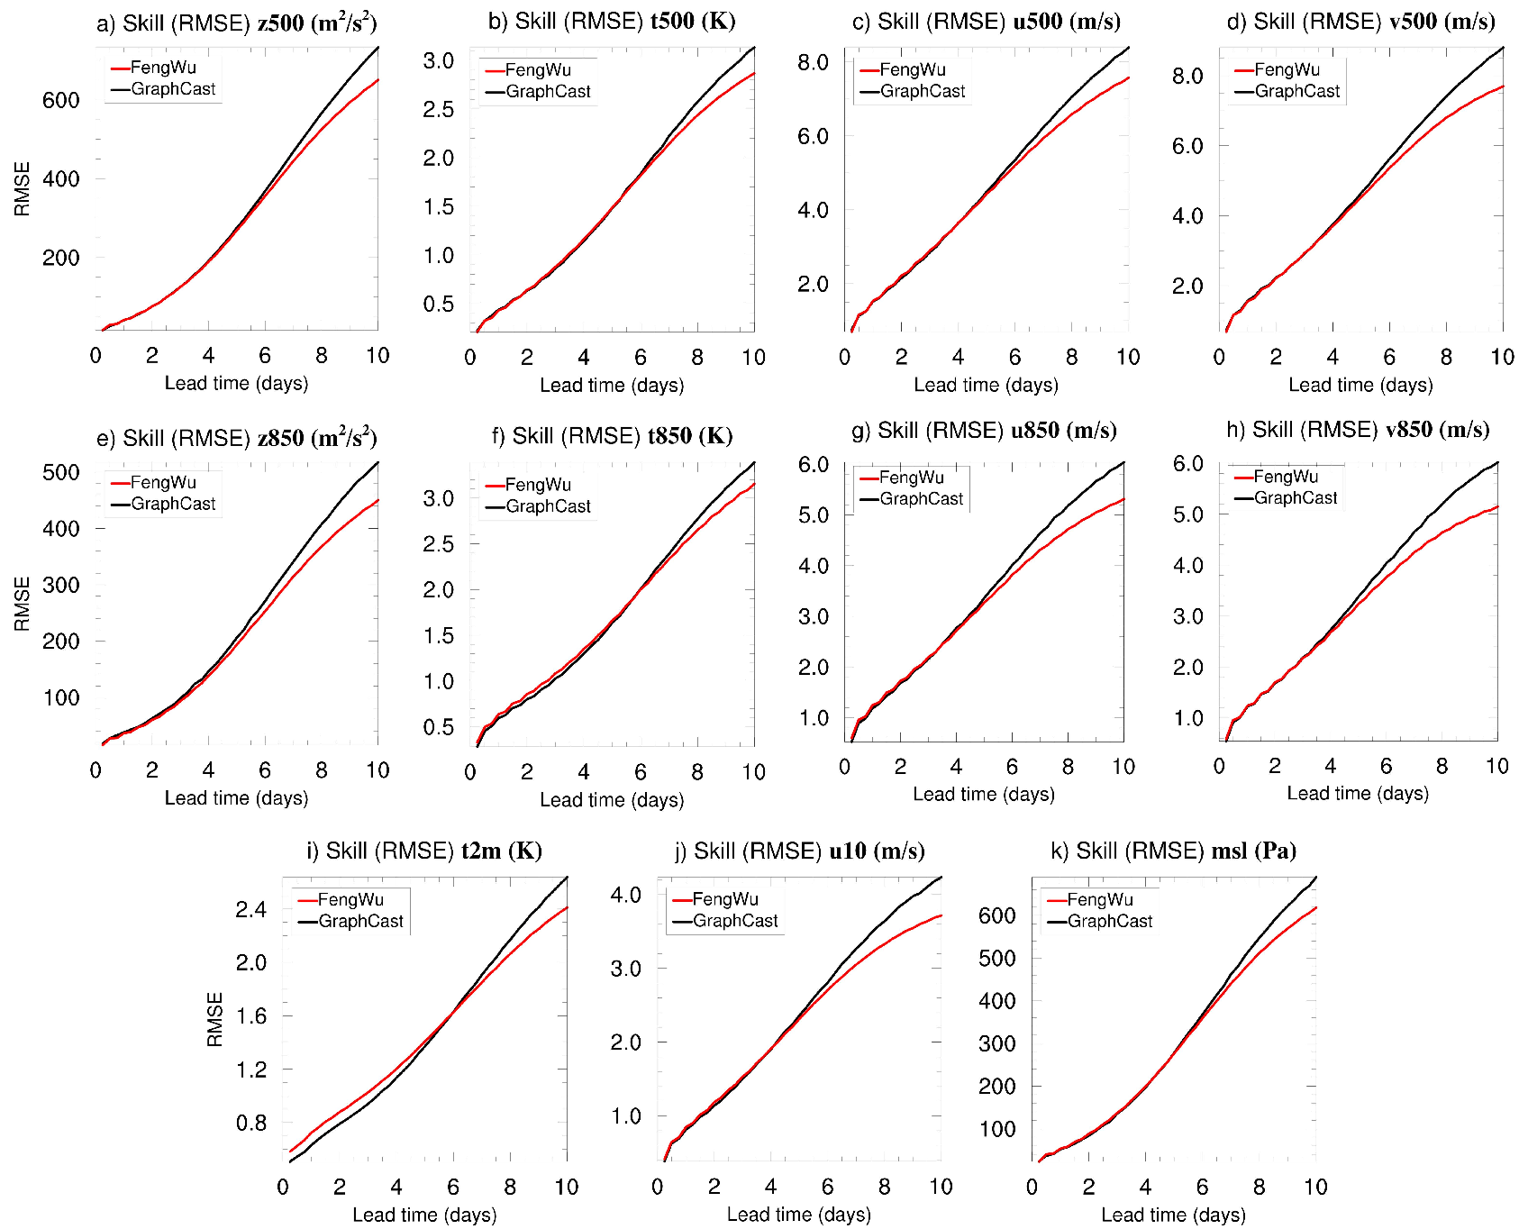
Performance of FengWu and GraphCast
FengWu achieves better performance than GraphCast (prior best model released by Deepmind in Dec of 2022) on 80% of the metrics (lower RMSE indicating better prediction).
FengWu reduces forecast errors by 10.87% compared to GraphCast and by 19.4% compared to IFS-HRES (the best physical model from ECMWF) for the ten days lead time.
Notes:
In this slide, we present the RMSE of FengWu and GraphCast in the year of 2018. The black line is the rmse of GraphCast while the red line is the rmse of FengWu and lower RMSE means better prediction performance. As can be observed, FengWu generally achieves better performance than GraphCast, which is the previous best AI model. More specifically, fengwu achievers better performance on 80% precents of all variables reported by graphcast. The performance gain is more obvious from day 5 to day 10. Specifically, FengWu reduces forecast errors by 10.87% compared to GraphCast and by 19.4% compared to IFS-HRES for the ten days lead time.

Slide 17
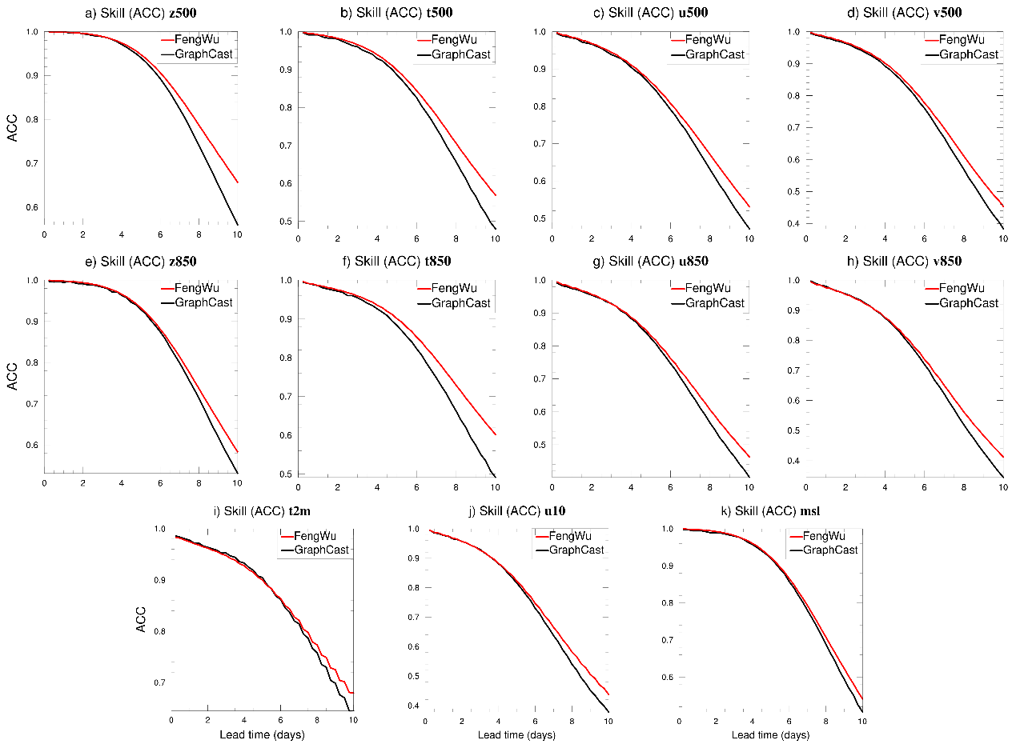
Performance of FengWu and GraphCast
ACC of FengWu and GraphCast
Notes:
We also reported the acc of both fengwu and graphcast, and the observations are similar.

Slide 18
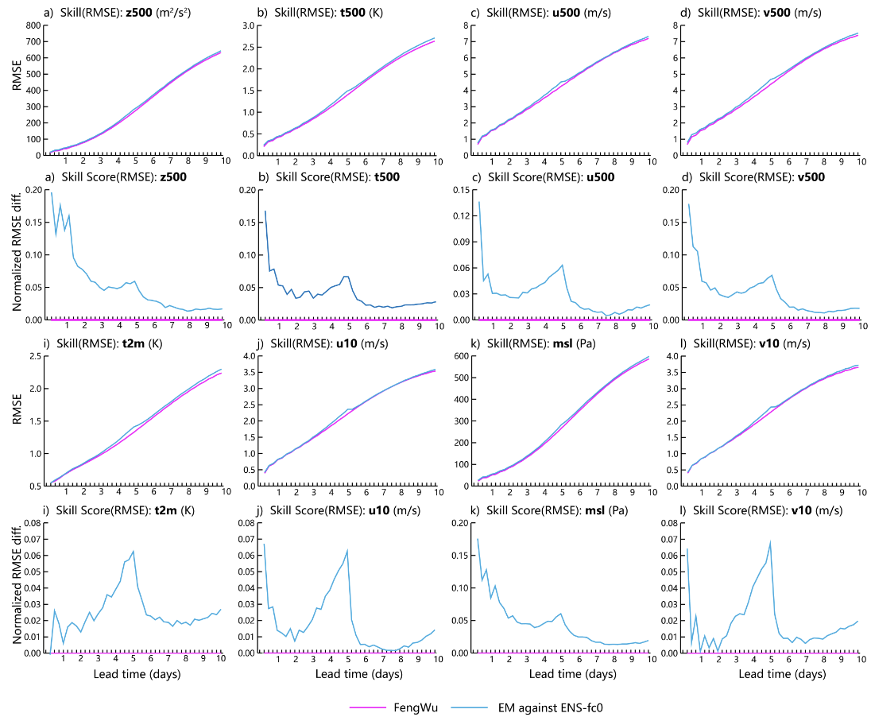
Evaluations
The prediction performance of FengWu is also better than ECMWF-EM.

Slide 19
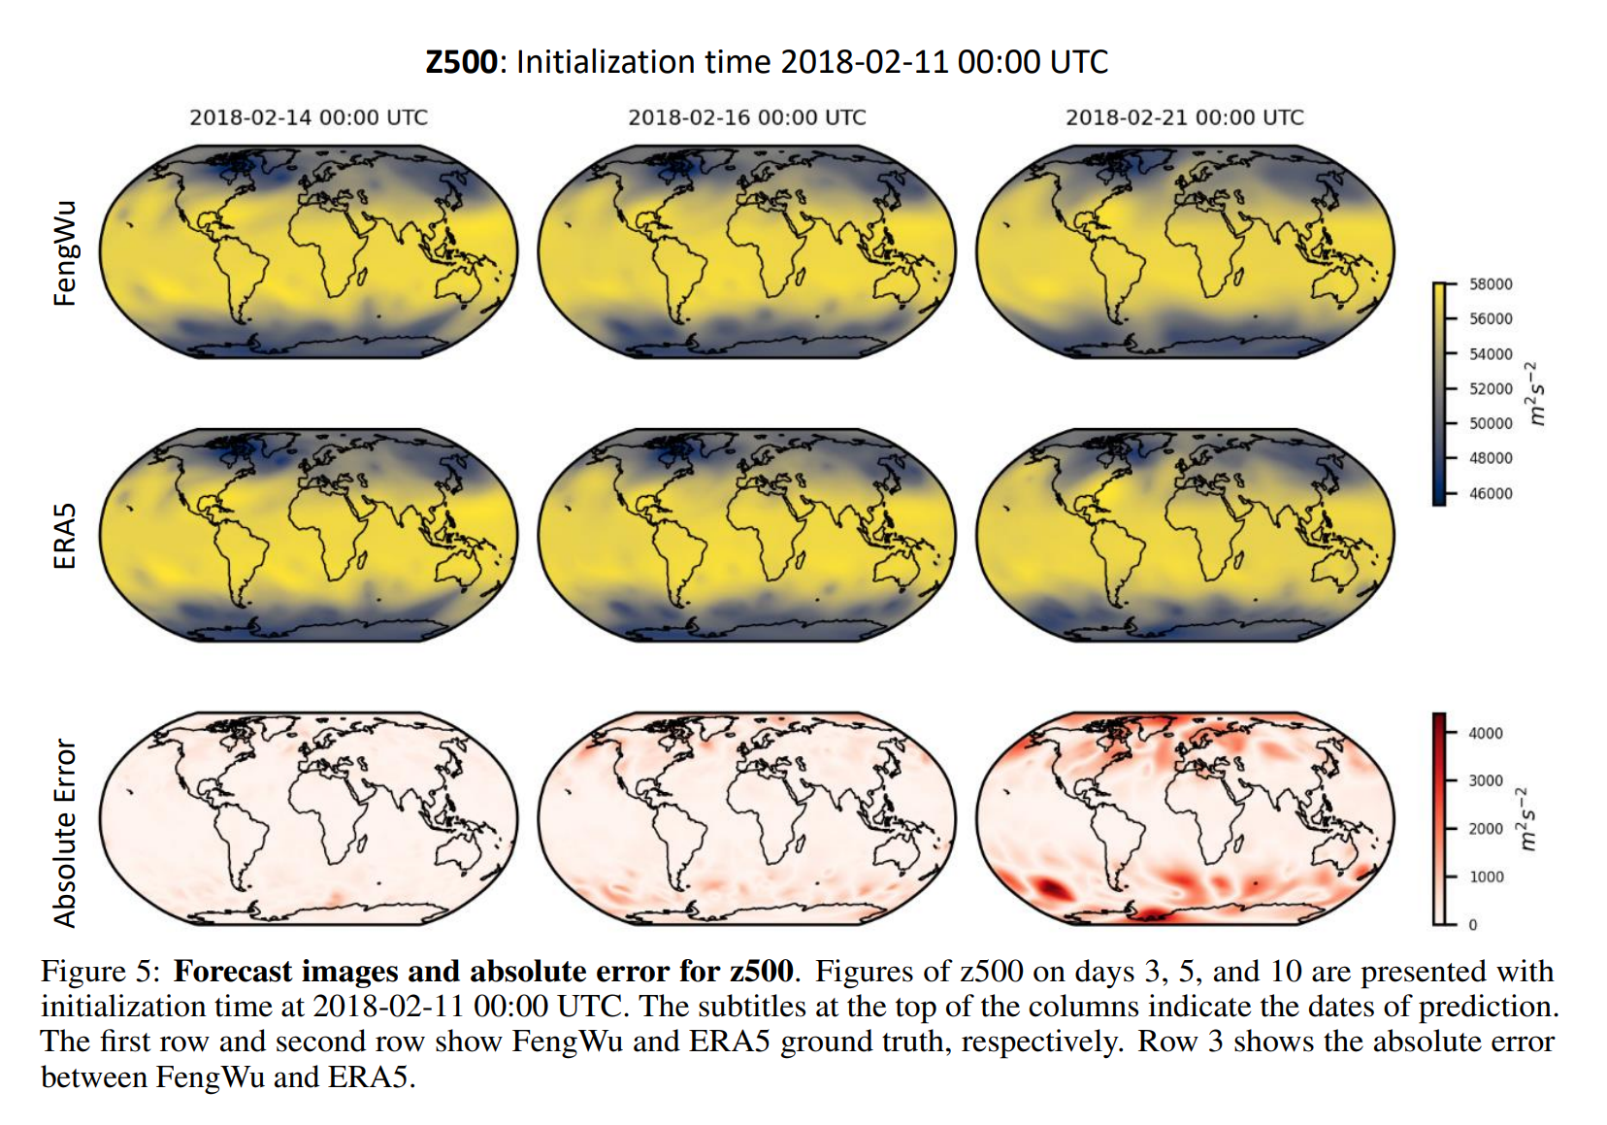
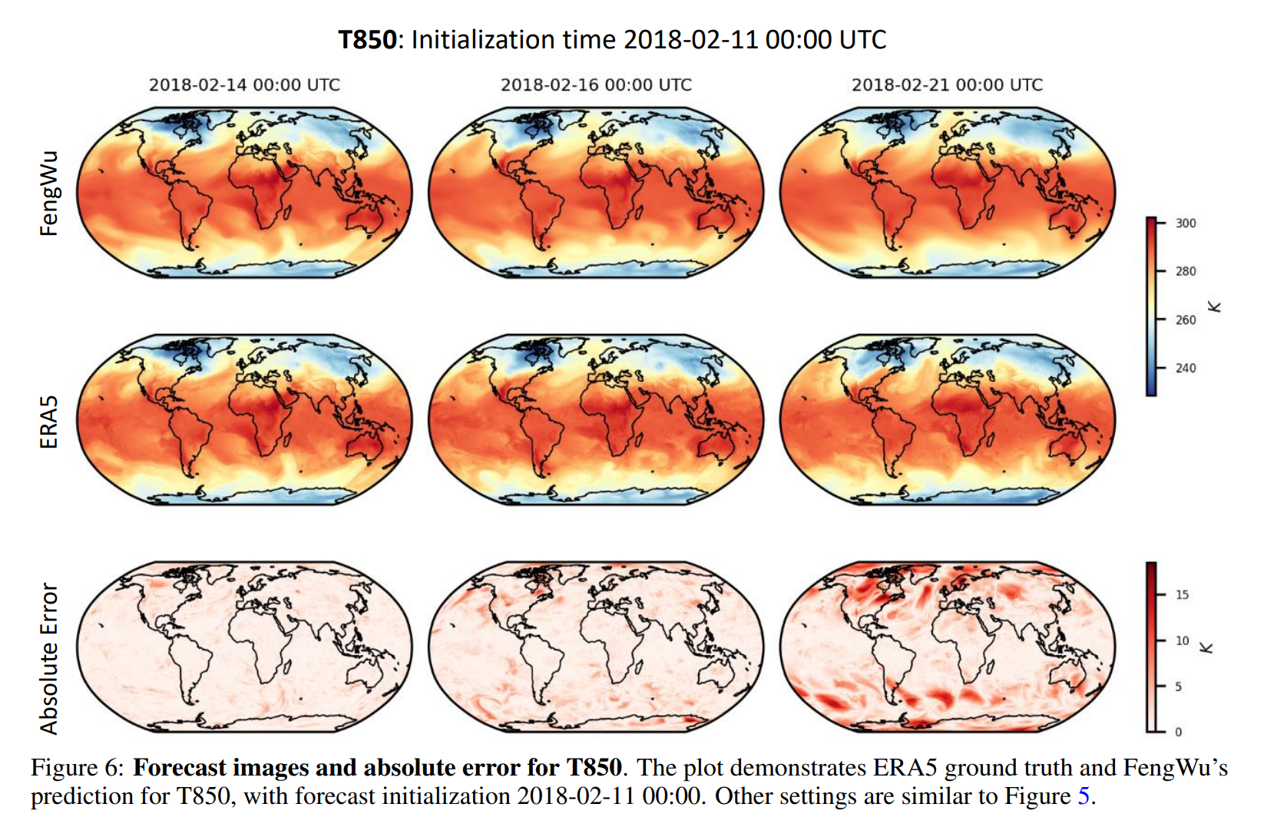
Visualization
Predictions and errors visualization for Z500 and T850. Initialization time: 2018-Feb-11-00:00
Notes:
We visualize the predicted results of FengWu at lead days 3, 5, and 10 for two variables, i.e., z500 (geopotential at the pressure level of 500 hPa) and t850 (the temperature at the pressure level of 850 hPa), and compare the predictions with the ERA5. In these two figures, the top two rows show the sequences of states from FengWu and ERA5, and the third row shows the absolute value of the error from FengWu to ERA5. In both visualizations, FengWu has outcomes very close to ERA5 on the third day. As the forecast step increases, the absolute error increases and diffuses to adjacent areas. These visualizations validate FengWu’s ability to estimate weather states approximating the real data.

Slide 20
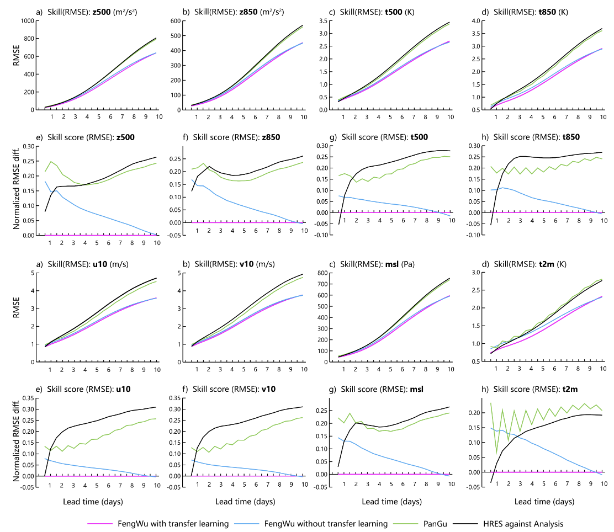
Towards operational forecast
A new version of FengWu is trained with 13 levels ERA5 data for operational forecast
Evaluated on the year of 2022 with operational analysis inputs
Notes:
After demonstrating the effectiveness of FengWu with ERA5 as input, another important question is how would it perform in operational scenarios since the reanalysis data can not be obtained for operational use.
For this purpose, we a new version of FengWu that works on 13 levels since the released operational analysis data does not have 37 levels. Then, we conducted tests of both our "Fengwu" model and "Pangu" model using the 2022 analysis and ERA5 datasets. In the graph, the blue line represents the results of our "Fengwu" model using analysis data from EC, the pink line represents the results of our "Fengwu" model using ERA5 data, the gray line corresponds to the results of the "Pangu" model using analysis data, and the orange line represents the "Pangu" model's performance on ERA5 data.
From the results, it is evident that our model maintains a relatively high level of performance on analysis data, and there is only minimal degradation in performance. This suggests that our model's capabilities are robust and show consistency across different datasets. Besides, we also confirm that FengWu can still achieve skillful global weather forecasting more than 10 day in wht the operational analysis data.

Slide 21
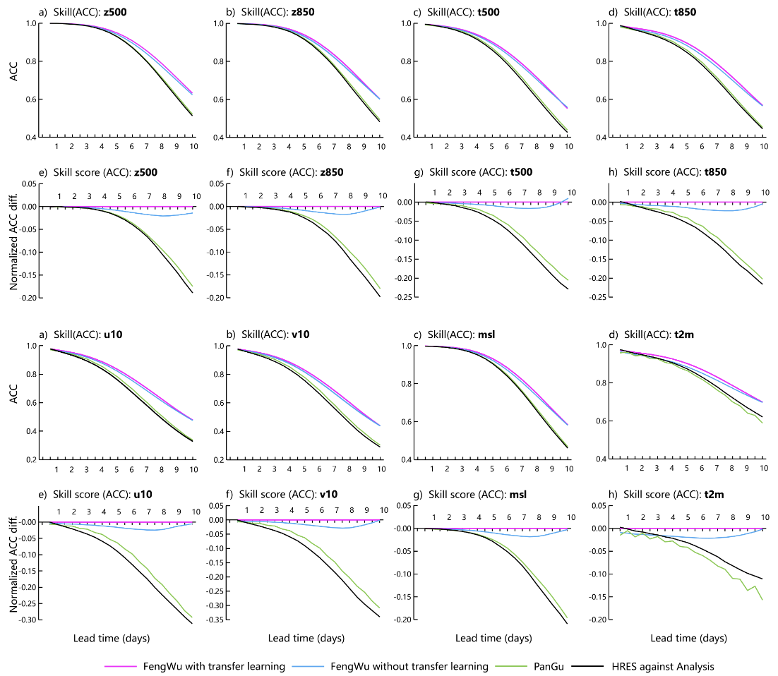
Towards operational forecast
A new version of FengWu is trained with 13 levels ERA5 data for operational forecast
Evaluated on the year of 2022 with operational analysis inputs
Take Z500 WACC>0.6 as the skillful prediction criterion, the skillful prediction lead time of FengWu is still longer than 10 days.
Notes:
After demonstrating the effectiveness of FengWu with ERA5 as input, another important question is how would it perform in operational scenarios since the reanalysis data can not be obtained for operational use.
For this purpose, we a new version of FengWu that works on 13 levels since the released operational analysis data does not have 37 levels. Then, we conducted tests of both our "Fengwu" model and "Pangu" model using the 2022 analysis and ERA5 datasets. In the graph, the blue line represents the results of our "Fengwu" model using analysis data from EC, the pink line represents the results of our "Fengwu" model using ERA5 data, the gray line corresponds to the results of the "Pangu" model using analysis data, and the orange line represents the "Pangu" model's performance on ERA5 data.
From the results, it is evident that our model maintains a relatively high level of performance on analysis data, and there is only minimal degradation in performance. This suggests that our model's capabilities are robust and show consistency across different datasets. Besides, we also confirm that FengWu can still achieve skillful global weather forecasting more than 10 day in wht the operational analysis data.

Slide 22
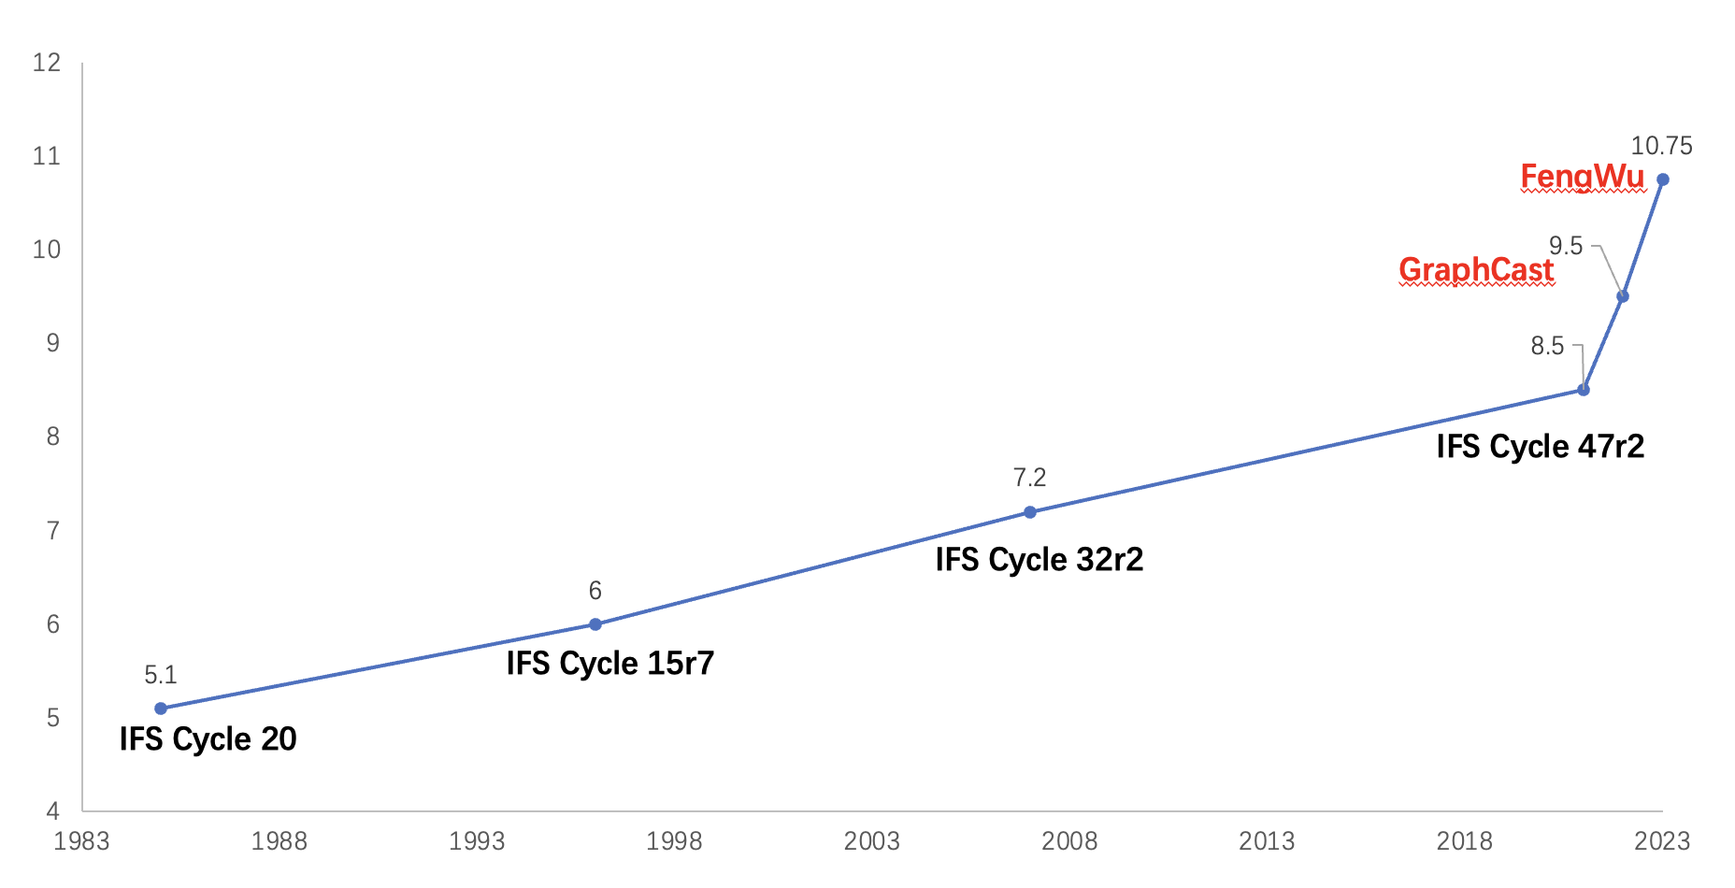
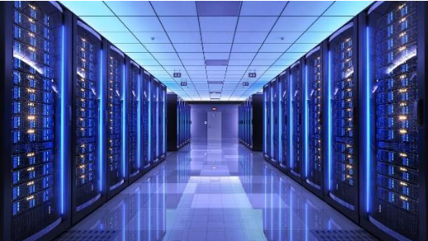
Core benefits
Long lead skillful forecasting
from 8.5 days to 10.75 days from Z500, and 14 days for t2m
Fast development
Efficiency: Generating the predictions for the next 10 days of all regions in the world with 1 GPU cards with 30 seconds
Physical models require over 10K nodes runing one hour for generating 10 days’ forecasts
FengWu only requires one GPU card running 30 seconds for generating 10 days’ forecasts
Redue the computation costs over 2000 times
Notes:
Based on the previous analysis, I summarize the core befinits of FengWu to two points, the first one is the long lead skillful forecasting. By using the acc of z500 bigger than 0.6 as skifull forecasting, we conclude that FengWu can push the skillful global weather forecasting beyond 10 days, which has never been achieved previously. Besides, we can observe from the right figure, the development speed of global weather forecasting is significantly boosted. Before AI is applied, it costs almost 10 years to improve the skillful global weather forecasting with one day. But now, we may only use several months.
Another benefit is definitely the efficiency, which should be general for all ai methods. In our experiment, we found that fengwu can generate the predictions for the next 10 days of all regions in the world with 1 GPU cards within 30 seconds

Slide 23
｜The Fourth Part –
Tropical Cyclone Predictions

Slide 24
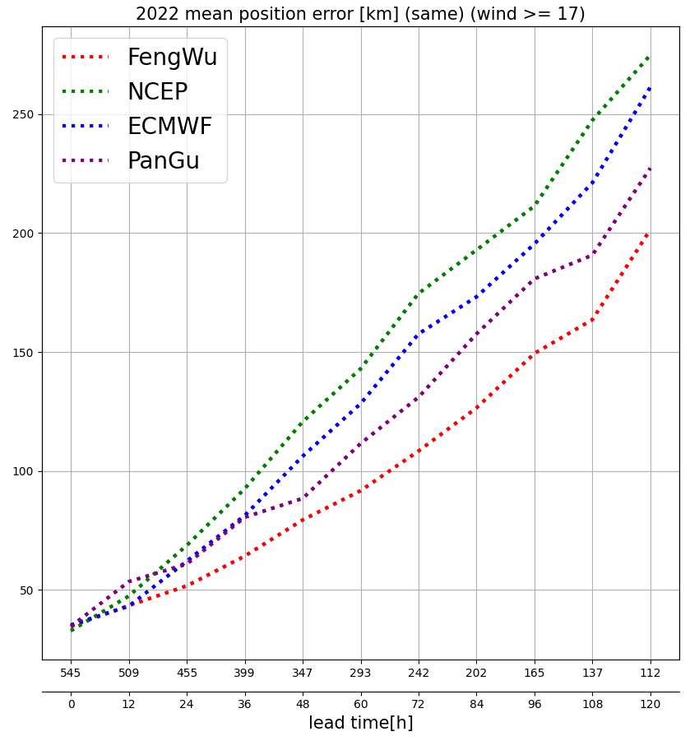
Tropical Cyclone Predictions
FengWu achieves the best tropical Cyclones tracking performance within 5 days.
Evaluated on all the tropical Cyclone occurred in the year of 2022 (the same samples)
Notes:
And we also evaluate the ability of FengWu in predicting extreme weather events such as tropical Cyclones , which is one of the most impactful weather events and obviously has a huge impact on coastal cities such as Shanghai.
We collected the postion of all tropical Cyclones in the year of 2022 corresponding to the predicitons from ECMWF-IFS and NCEP-GFS, and we run FengWu and the realeased pangu model with the operation analysis input.
Left figure shows the tropical Cyclones track error based on the same samples, and we can see that FengWu achieves the best tropical Cyclones tracking performance within 5 days. The right figure shows the error bar of different lead time, from where we can see that the error distribution of FengWu is quiet similar to ECMWF.

Slide 25
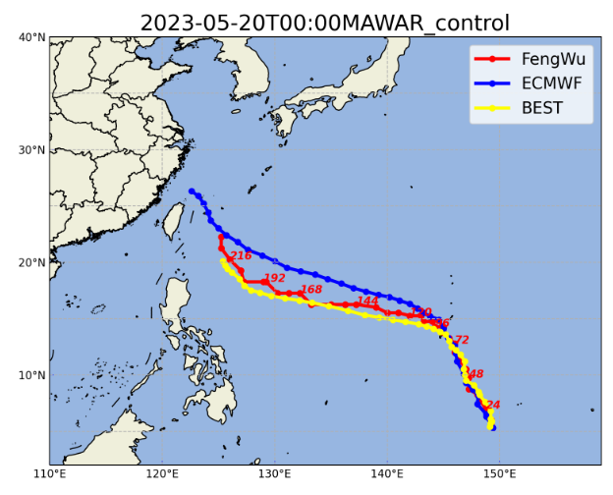
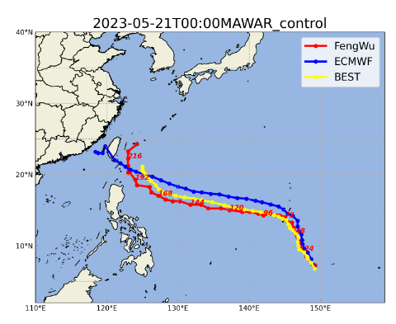
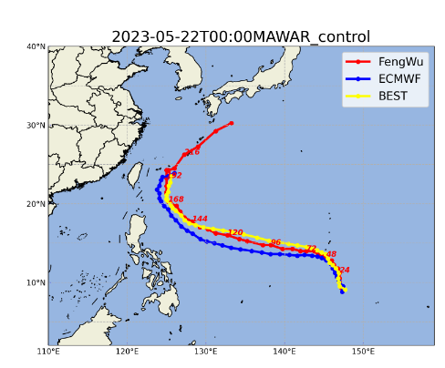
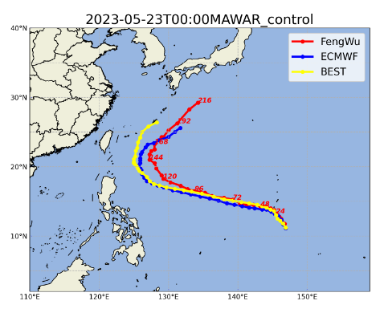
Tropical Cyclone Predictions
Tropical Cyclone Track Prediction of Mawar
Notes:
In this slide, we show the track forecasts of a recent typhoon named Mawar with our FengWu and the ECMWF-IFS on four different intialtial fileds. The yellow line is the best track of typhoon, the red line is the predictied path of FengWu and the blue line is the predicted path from ECMWF. As can be observed, the performance of FengWu is consistently competitive or even better that HERS in Typhoon path prediction.

Slide 26
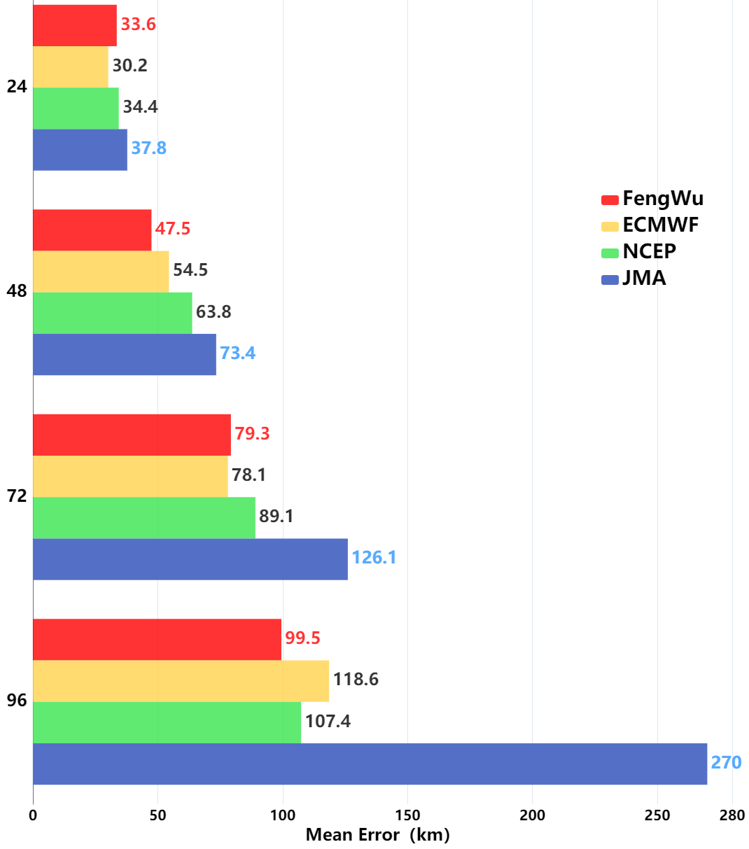
Tropical Cyclone Predictions
Tropical Cyclone Track Prediction of Khanun (ensure same samples
2023-Aug-1-00:00:00
2023-Aug-5-00:00:00
* Data provided by Shanghai Typhoon Institute of China Meteorological Administration
Notes:
We further present the operational forecast results of a typhoon named Khanun, in the recent with our model deployed in Shanghai meteorology administration.
In the left figure, the red bar shows the prediction error of FengWu at different lead times, while the yellow, green, and blue bars correspond to ECMWF-HERS, NCEP-GFS, and JMA model. The errors are calculated with the same samples. We can observe that FengWu almost always achieve the best typhoon track performance.
The two figures in the right present the predicted tracks of FengWu, ECMWF, NCEP and the best track at two different initial time. We can see that FengWu can accurately predict the two sharp turns in Khanun’s track, demonstrating it’s superior ability.

Slide 27
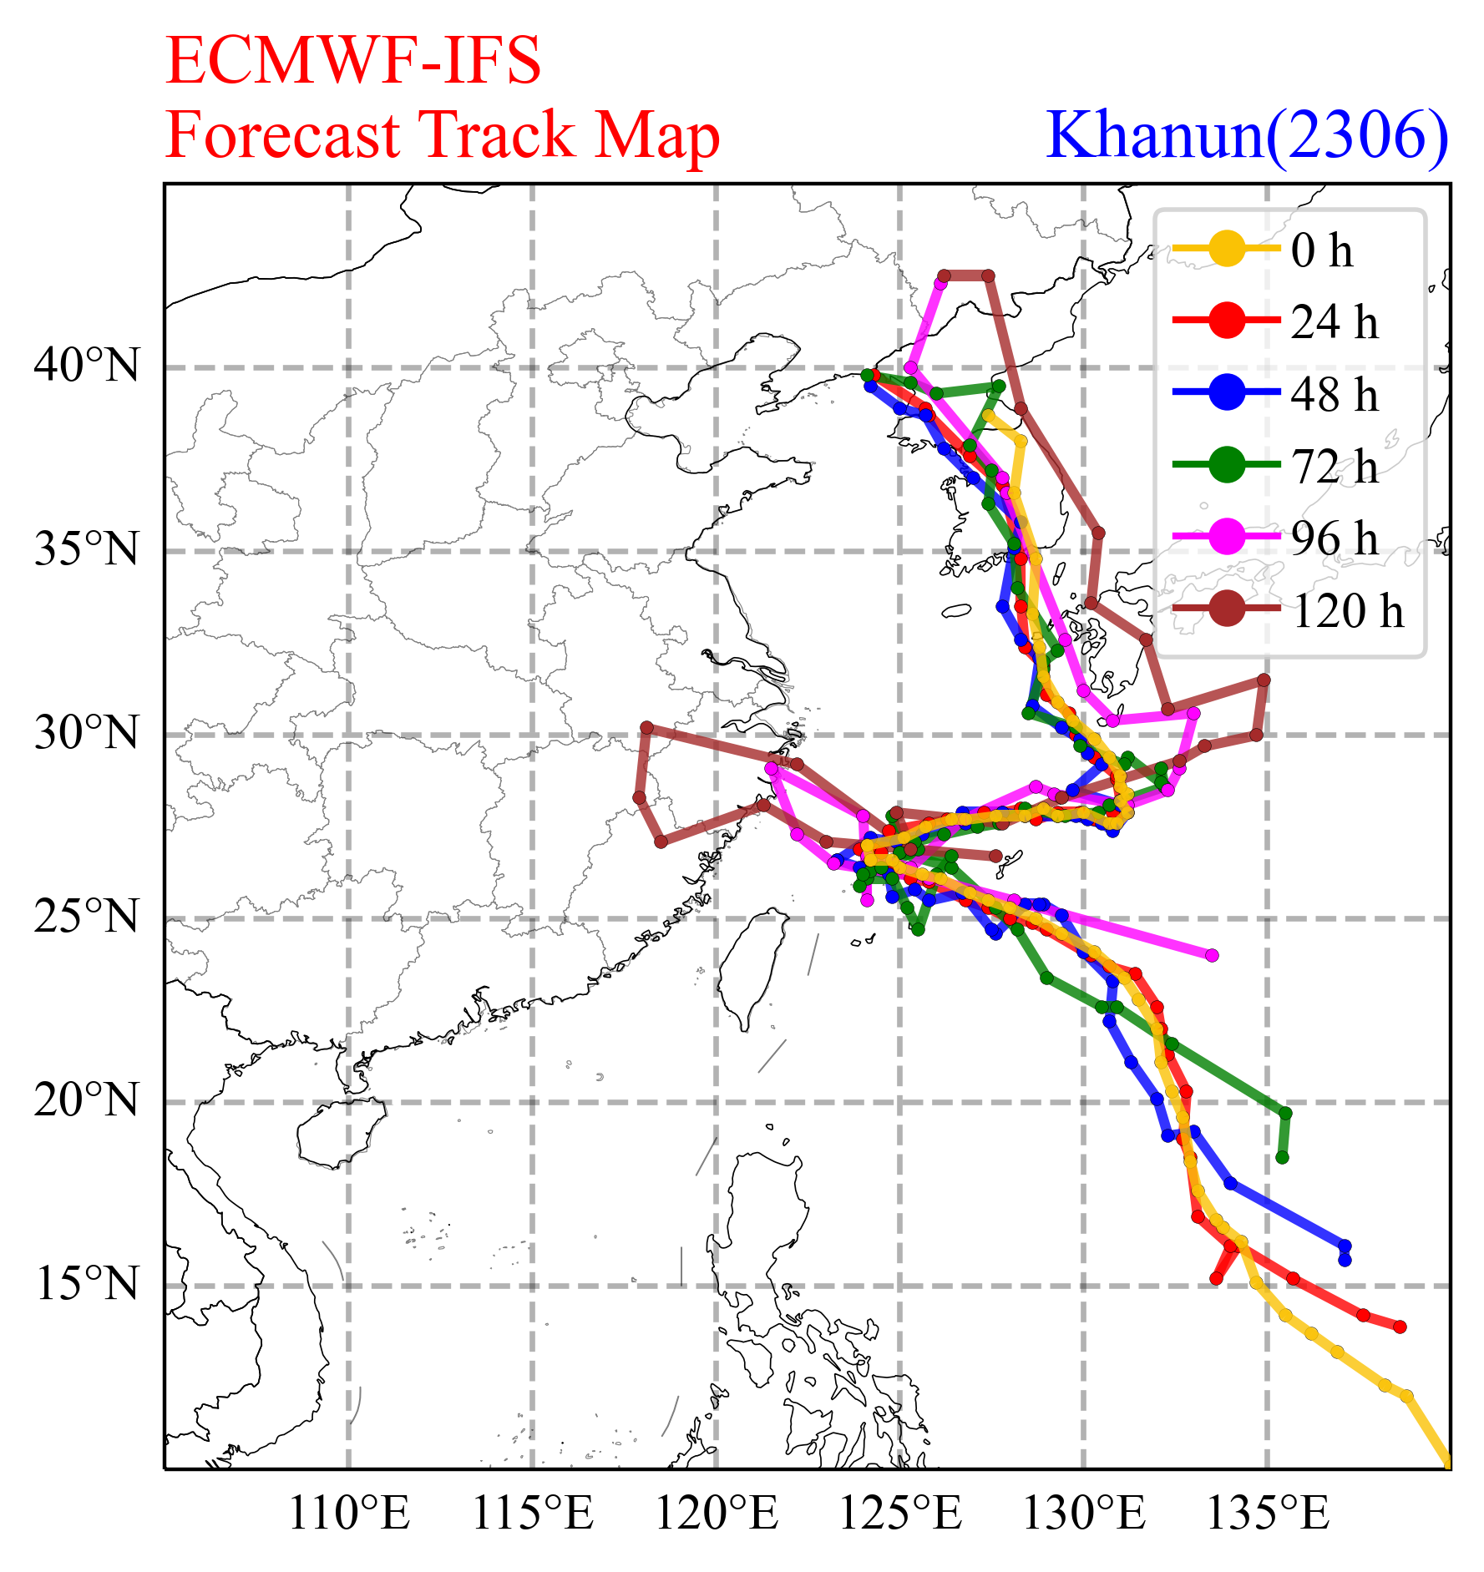
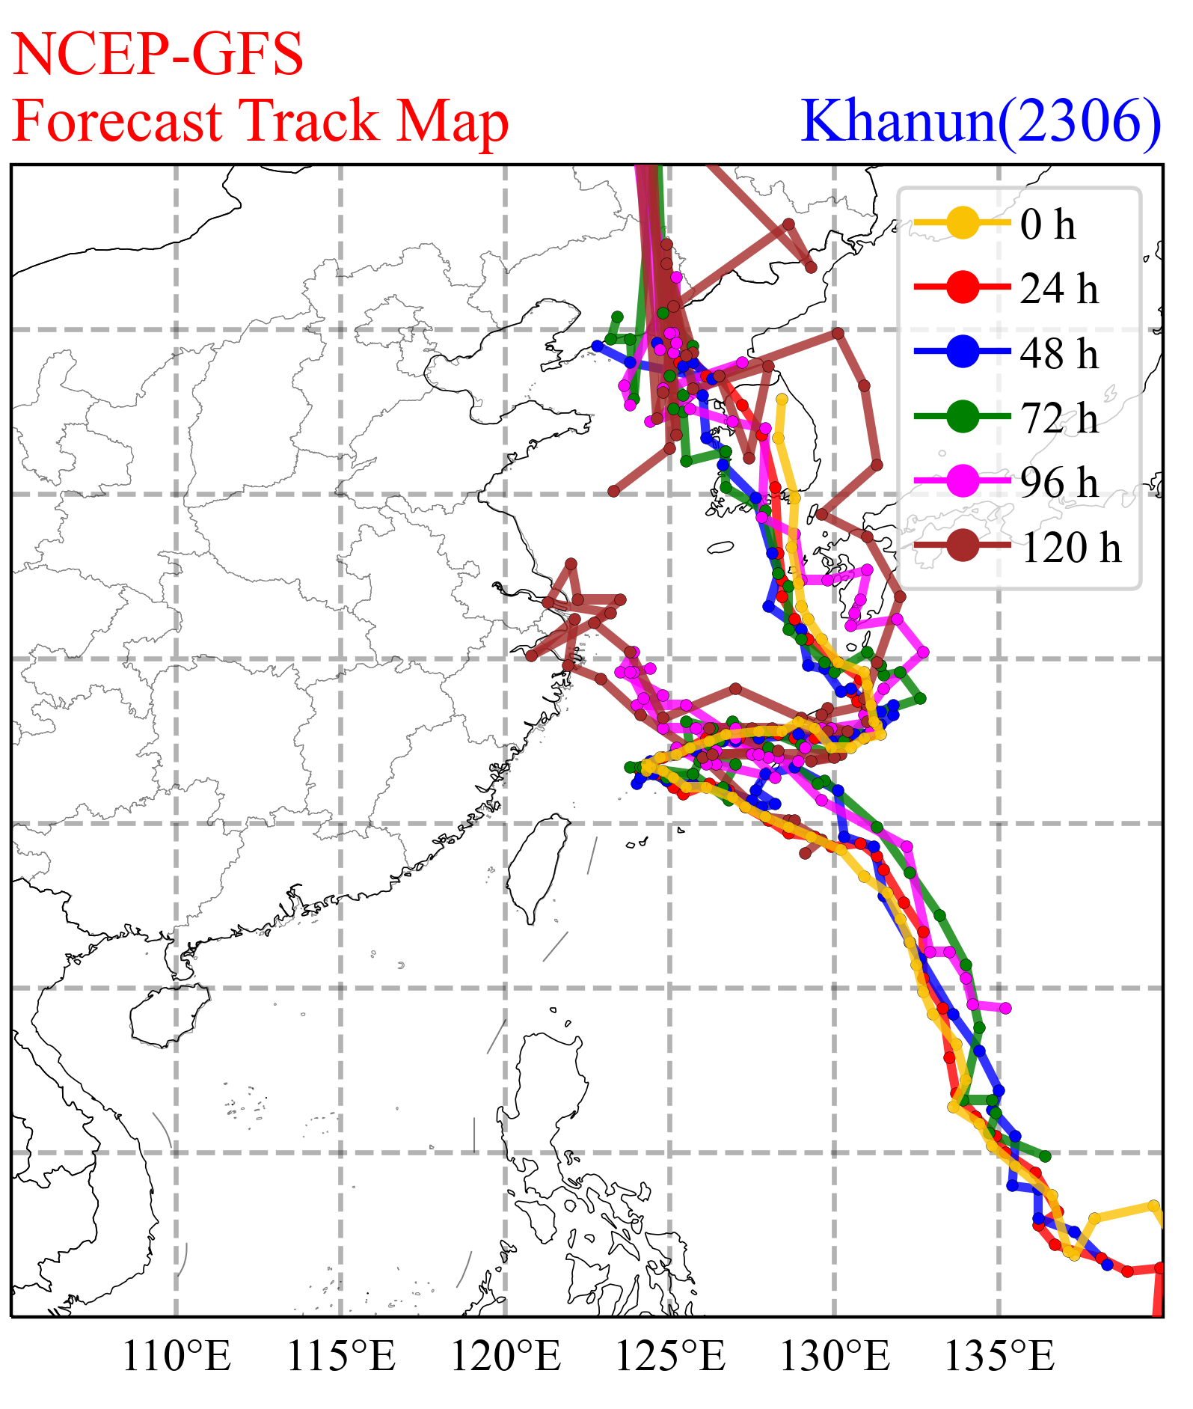
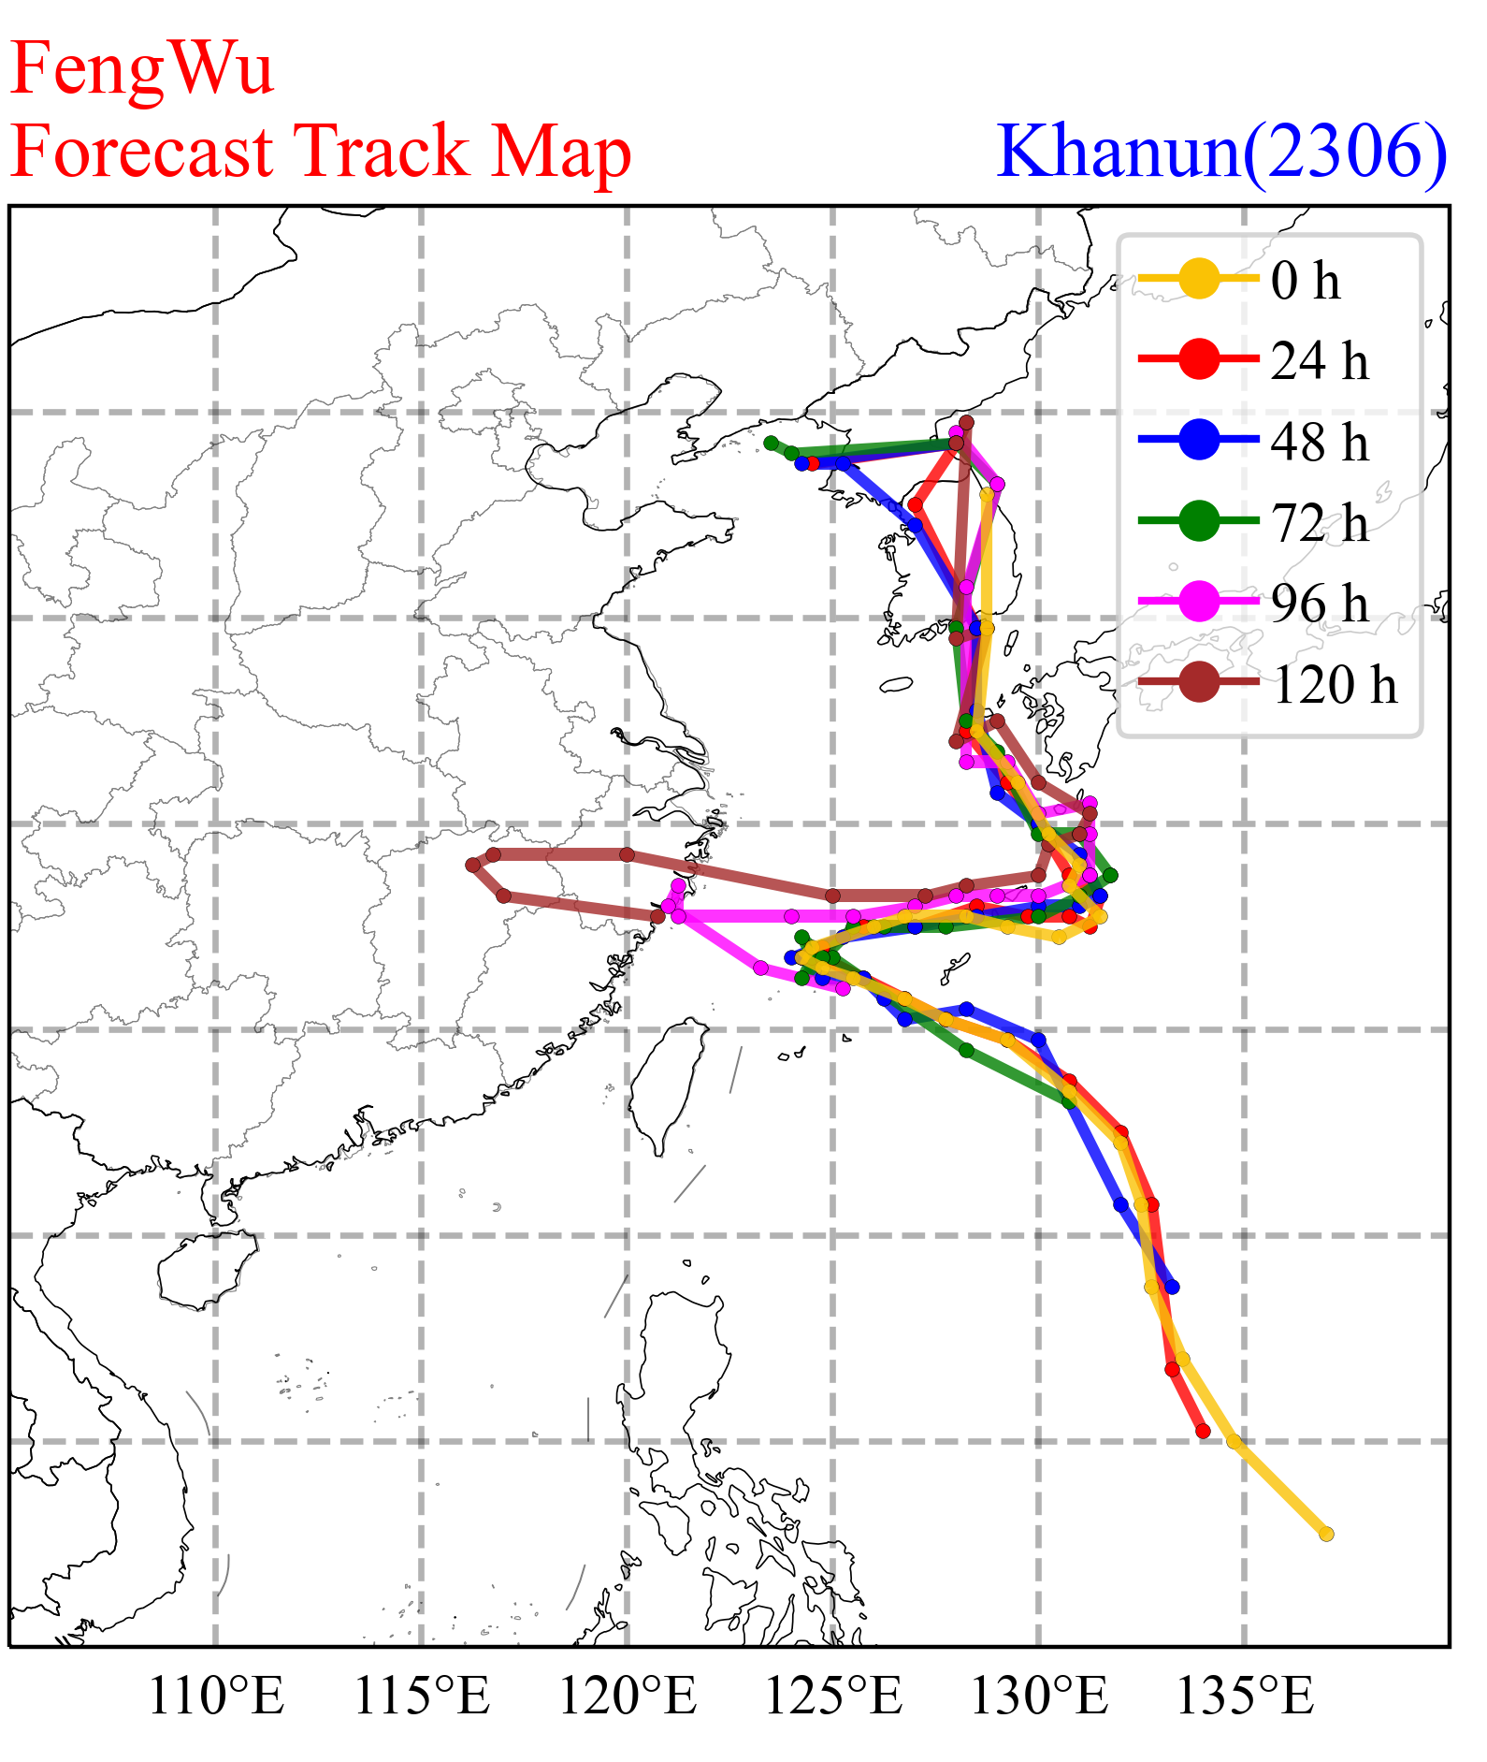
Results from Shanghai Typhoon Institute
Operational Khanun track prediciton analysis for ECMWF-IFS, NCEP-GFS, and FengWu
* Figures provided by Shanghai Typhoon Institute of China Meteorological Administration
Notes:
The slide visualize the locations of groundtruth and predicted the typhoon center with different lead times for ECMWF-IFS, NCEP-GFS, and our FengWu. Except that fengwu’s prediction is the closest to the best track, we can also find that the error pattern of fengwu is more similar to ECMWF-IFS. For example, in the first sharp turn, Fengwu’s prediction are shifted to the west, which is the same as ECMWF-IFS. Maybe the reason is that our training data is ERA5.

Slide 28
Results from HKO
Performance of FengWu on Tropical Cyclone Track
Verification of TC tracks since Sep 2023 (larger sample size), including
Saola 蘇拉
Haikui 海葵
Kirogi 鴻雁
Yun-yeung 鴛鴦
2324 nameless
Koinu 小犬
Bolaven 布拉萬

Slide 29
Results from HKO
Performance of FengWu on Tropical Cyclone Intensity
Verification of TC intensity since Sep 2023, including
Saola 蘇拉
Haikui 海葵
Kirogi 鴻雁
Yun-yeung 鴛鴦
2324 nameless
Koinu 小犬
Bolaven 布拉萬
Similar to other AI models, Fengwu forecast the tropical cyclones persistently too weak.

Slide 30
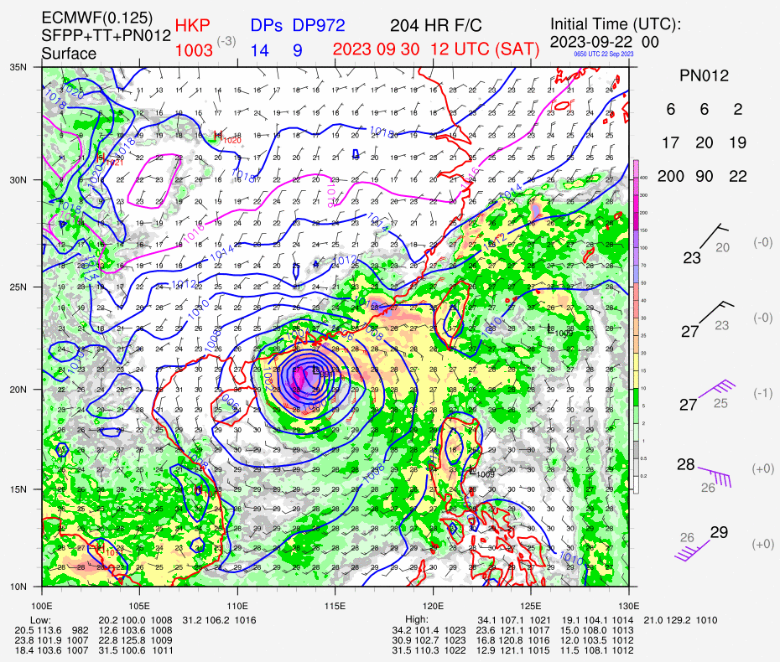
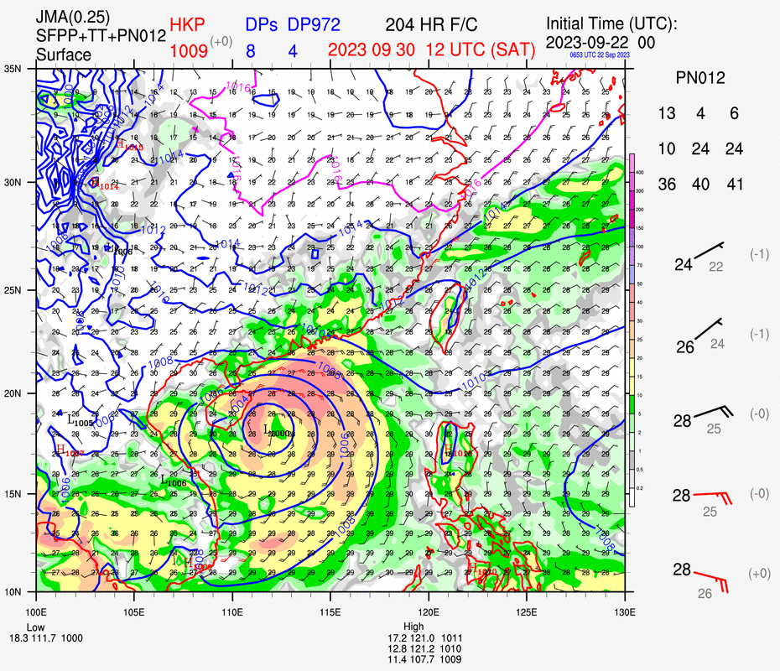
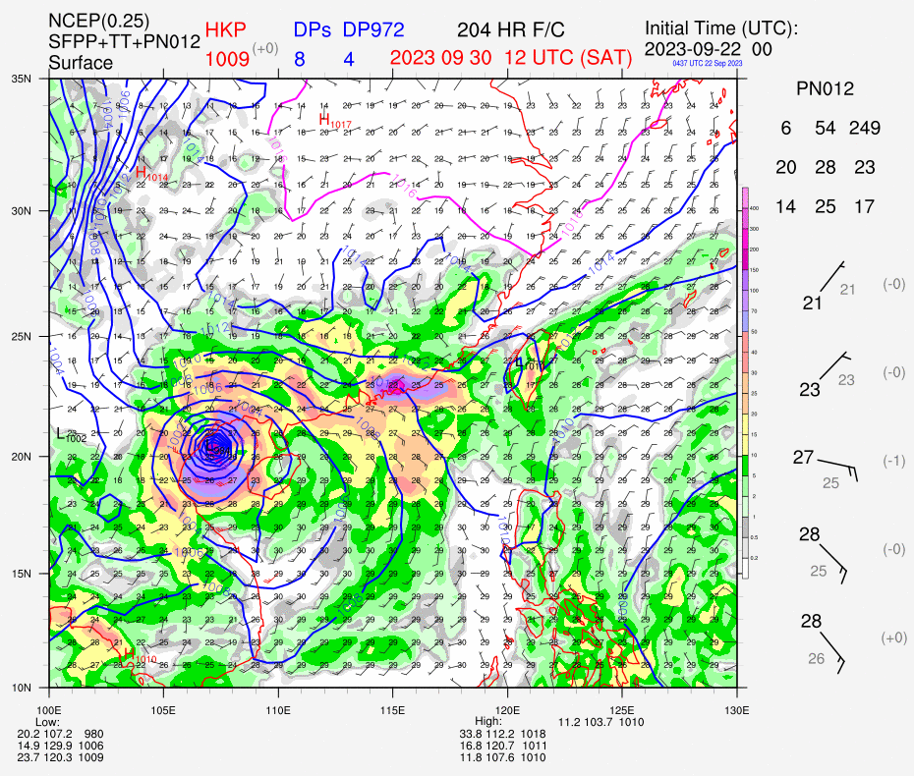
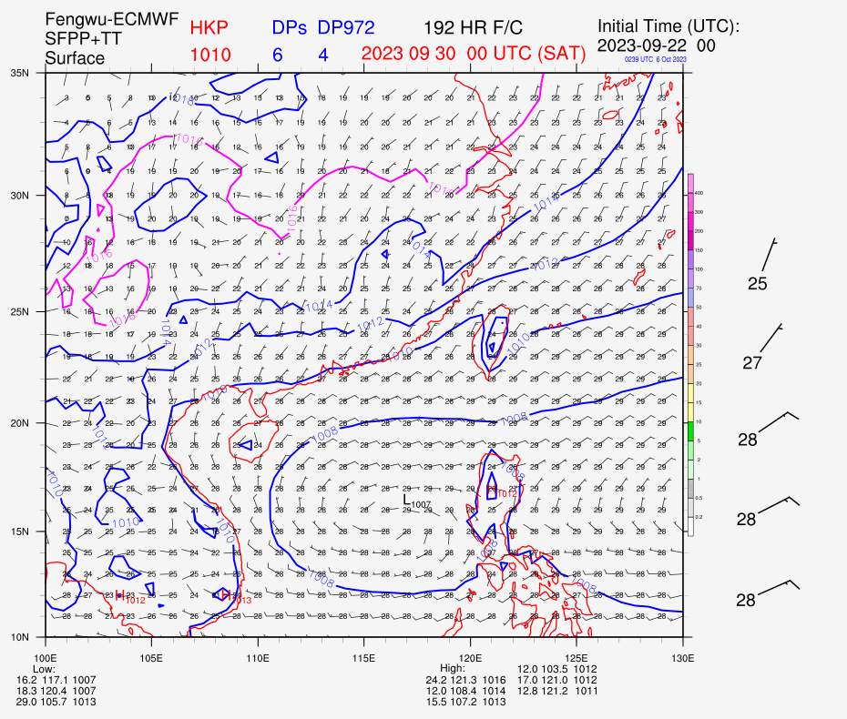
Results from HKO
Traditional numerical weather prediction models forecast a potential tropical cyclone to form and affect northern part of South China Sea over the Mid-Autumn Festival (29-30 September).
FengWu correctly forecast that TC would not form.
ECMWF
JMA
NCEP

Slide 31
Takeaways
FengWu is an AI-based weather forecasting model that can generate skillful global weather predictions with 37 vertical levels beyond 10 days lead time.
FengWu is computation efficient, which can run on personal laptops with a GPU card and generate the next 10 days predictions within 1 minute.
FengWu is easy to deploy, any organization can make it work within one day!
We can provide help for the deployment.
FengWu achieves better tropical cyclone track prediction performance than ECMWF-HERS and NCEP. It decrease the average five-day track prediction error to 200km.
The tropical cyclone intensity prediction of FengWu could be further improved.
For more details: check the paper “FengWu: Pushing the Skillful Global Medium-range Weather Forecast beyond 10 Days Lead”(https://arxiv.org/abs/2304.02948).
Notes:
Based on the previous analysis, I summarize the core befinits of FengWu to two points, the first one is the long lead skillful forecasting. By using the acc of z500 bigger than 0.6 as skifull forecasting, we conclude that FengWu can push the skillful global weather forecasting beyond 10 days, which has never been achieved previously. Besides, we can observe from the right figure, the development speed of global weather forecasting is significantly boosted. Before AI is applied, it costs almost 10 years to improve the skillful global weather forecasting with one day. But now, we may only use several months.
Another benefit is definitely the efficiency, which should be general for all ai methods. In our experiment, we found that fengwu can generate the predictions for the next 10 days of all regions in the world with 1 GPU cards within 30 seconds

Slide 32
Thanks
leibai.site
Notes:
Ok, that’s all for my today’s presentaion. If you want to know more about our team and get updates of research, you can visit my website: leibai.site. And also, hope we could get chance to meet in person and discuss the exicting ai4earth reseraches.

Slide 33
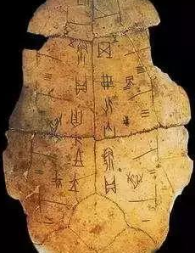
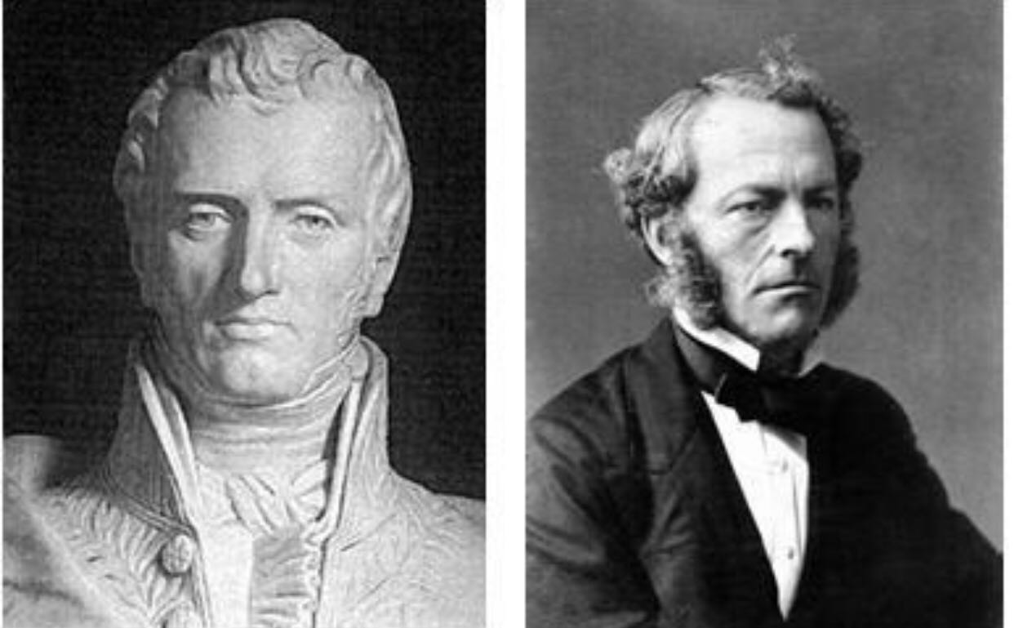
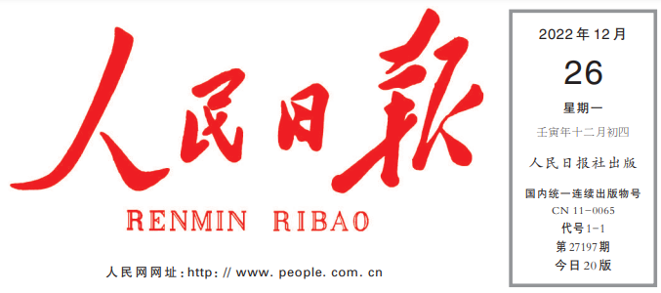
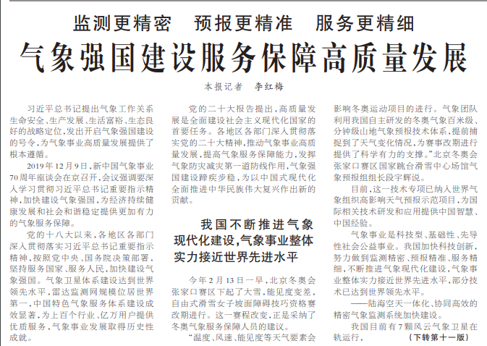
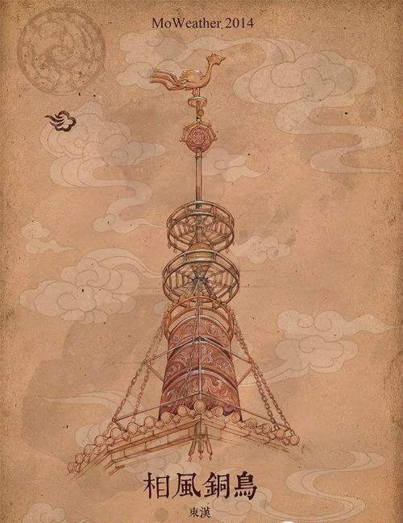
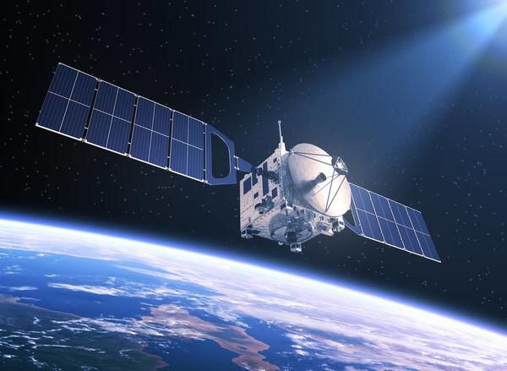
人工智能驱动的全球气象预报
理解地球尤其是大气
系统是人类自古的追求
当前的大气模拟核心
是物理驱动的数值求解
探索人工智能驱动的大气
模拟是国家战略和科学前沿
专家依赖
发展缓慢
无法准确
建模非线性
神学色彩
夏朝甲骨文
物理模型
经验主义
超算依赖
成本巨大
无法有效利
用海量数据
秦汉相风铜乌
超算和卫星

